Slide 1
British Airways
Customer ratings analysis and insights

Slide 2
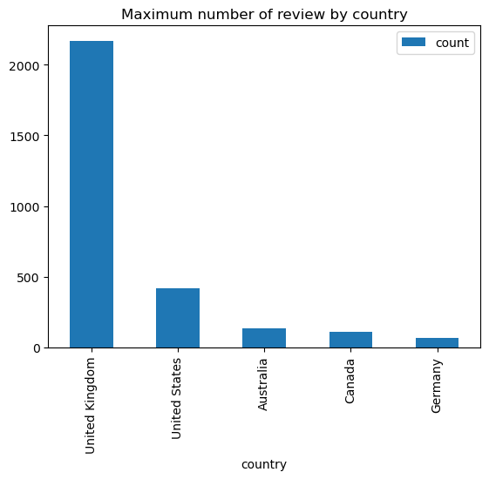
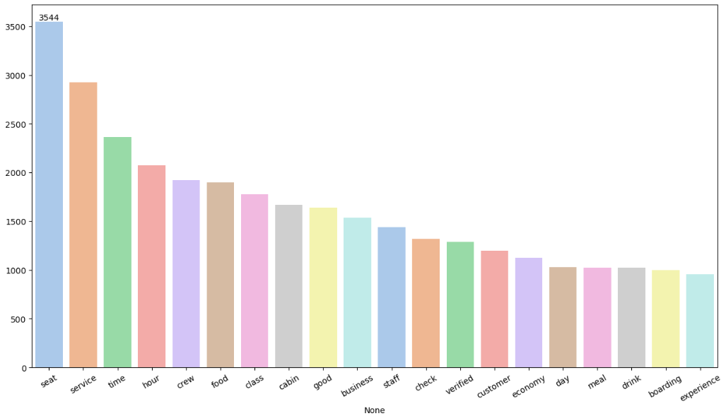
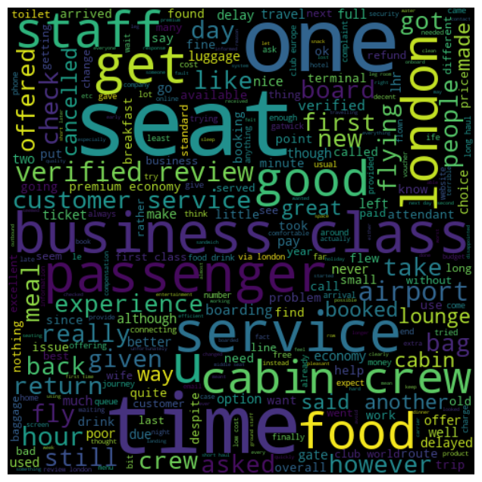
KEY METRICS
Average Overall Rating
4.51 /10
Reviews from 71 Countries
3499 Total reviews
collected
What customers are happy and unsatisfied about for different ratings class:
7–10 Ratings: Customers praised comfortable seats, good entertainment, and quality food.
4–6 Ratings: Customers faced issues with small screens, long queues, and inconsistent business class experiences.
1–3 Ratings: Customers were dissatisfied with cramped seating, small screens, and poor service despite liking the food.
All Customers liked Cabin crew service and staff, general economy seats. Many travelled in Business class.
Focus on – Economy class service, seats, enhance inflight entertainment experience and importantly Delays. Enhance the experience of business class, it seems customers want value for money. Improve Customer service on refund requests and process.

